Slide 1


Slide 2

Azure AD B2B – Invite your neighbors to your Cloud party!
Jan Vidar Elven | Microsoft MVP Enterprise Mobility
Cloud Architect @ Skill
@skillriver | gotoguy.blog
Notes:
In this session we will look at how you can invite & collaborate with Guests using Azure Active Directory B2B, how to manage guest identities from partners and individuals, conditional access, control access to services in Office 365 and the Microsoft Cloud! This session will be very practical for both IT admins and end users with a lot of demos and takeaways!

Slide 3

Azure Active Directory B2B
Access Apps & Data
Work with Partners
UserType = Guest
Invitation Flow – Customizable with API
Licensing
Notes:
Work with any user from any partner
Partners use their own credentials
No requirement for partners to use Azure AD
No external directories or complex set-up required
Simple and secure collaboration
Provide access to any corporate app or data, while applying sophisticated, Azure AD-powered authorization policies
Easy for users
Enterprise-grade security for apps and data
No management overhead
No external account or password management
No sync or manual account lifecycle management
No external administrative overhead

Slide 4

Invite Users
Admins invite:
Azure Portal / PowerShell
Information workers invite:
Access Panel
Teams/Groups
SharePoint Online/OneDrive for Business – Separate Invitation Flow!
Invitation Manager API:
Microsoft Graph
Notes:
https://developer.microsoft.com/en-us/graph/docs/api-reference/v1.0/api/invitation_post

Slide 5

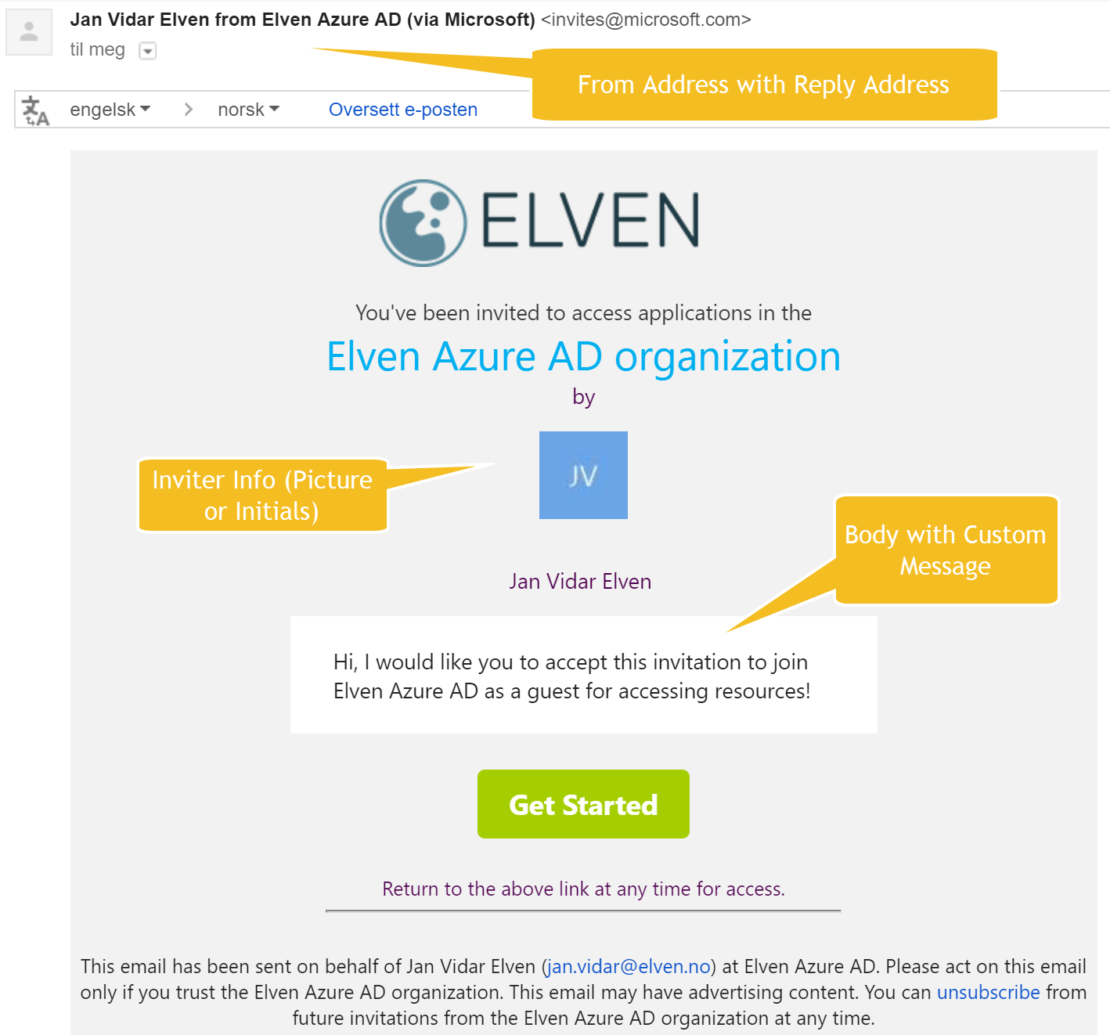
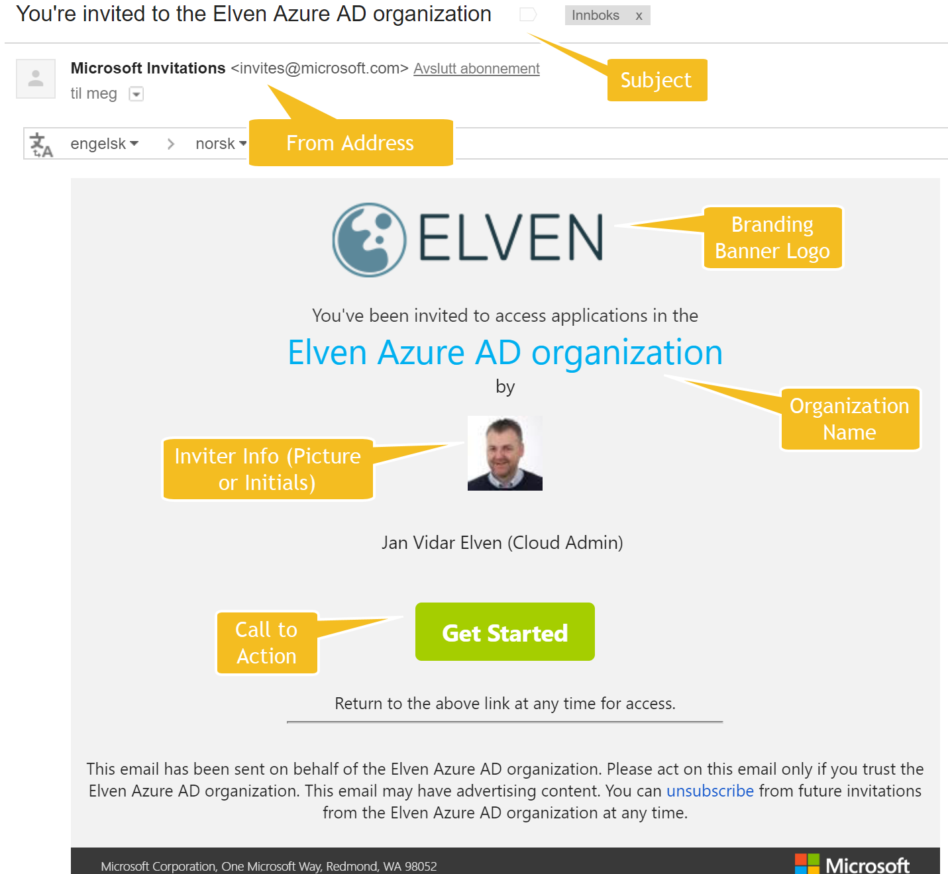
The invitation email

Slide 6
Invitation Redemption
Work/School Accounts and Microsoft Accounts
Social ID user first-time redemption
Source “Invited User” –>
“Microsoft Account”
“External Azure Active Directory”
Source for Members:
“Windows Server Active Directory ”
“Azure Active Directory”

Slide 7
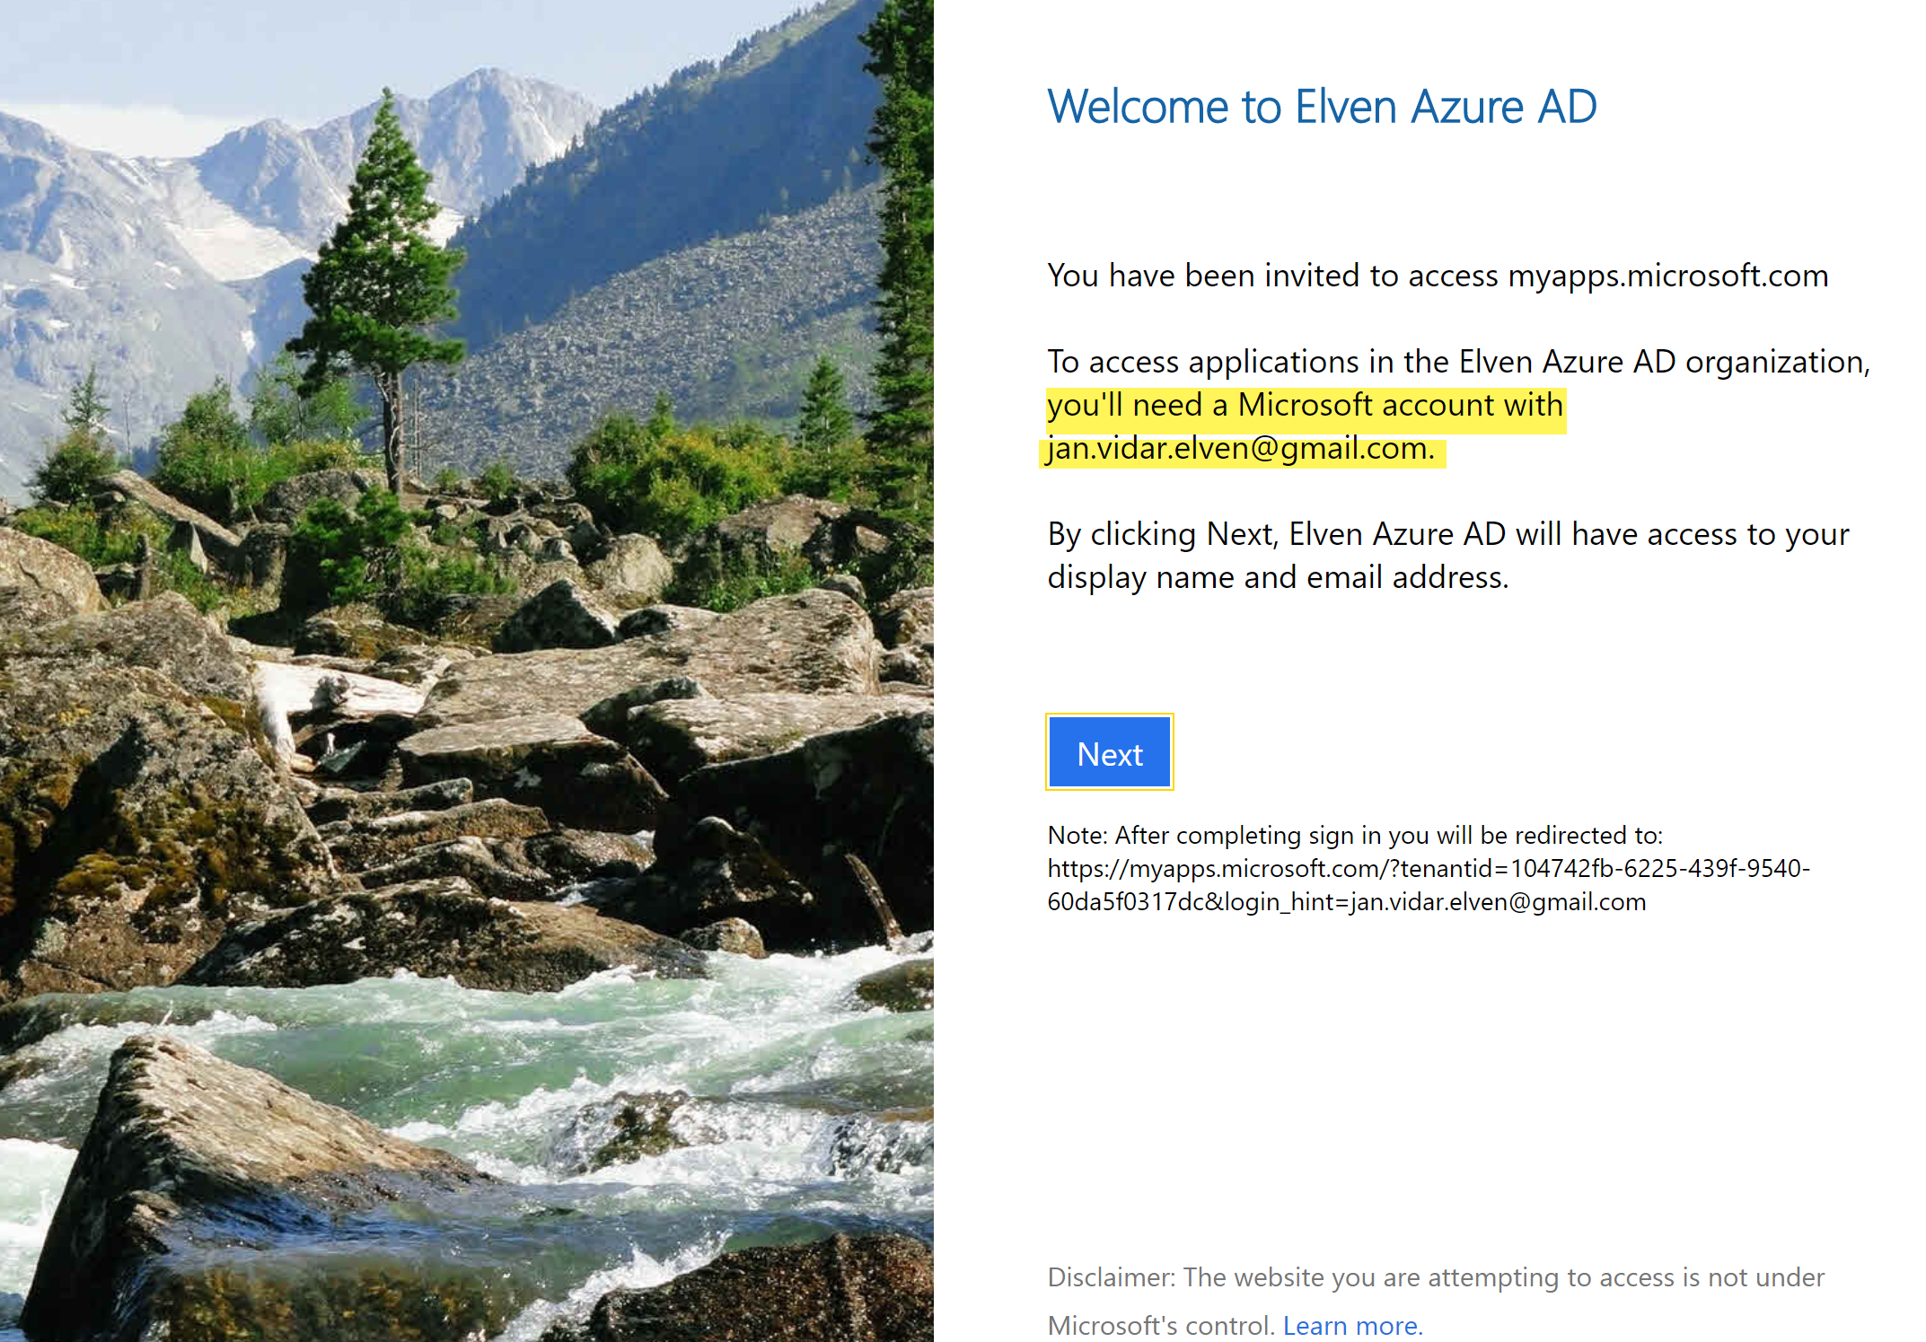
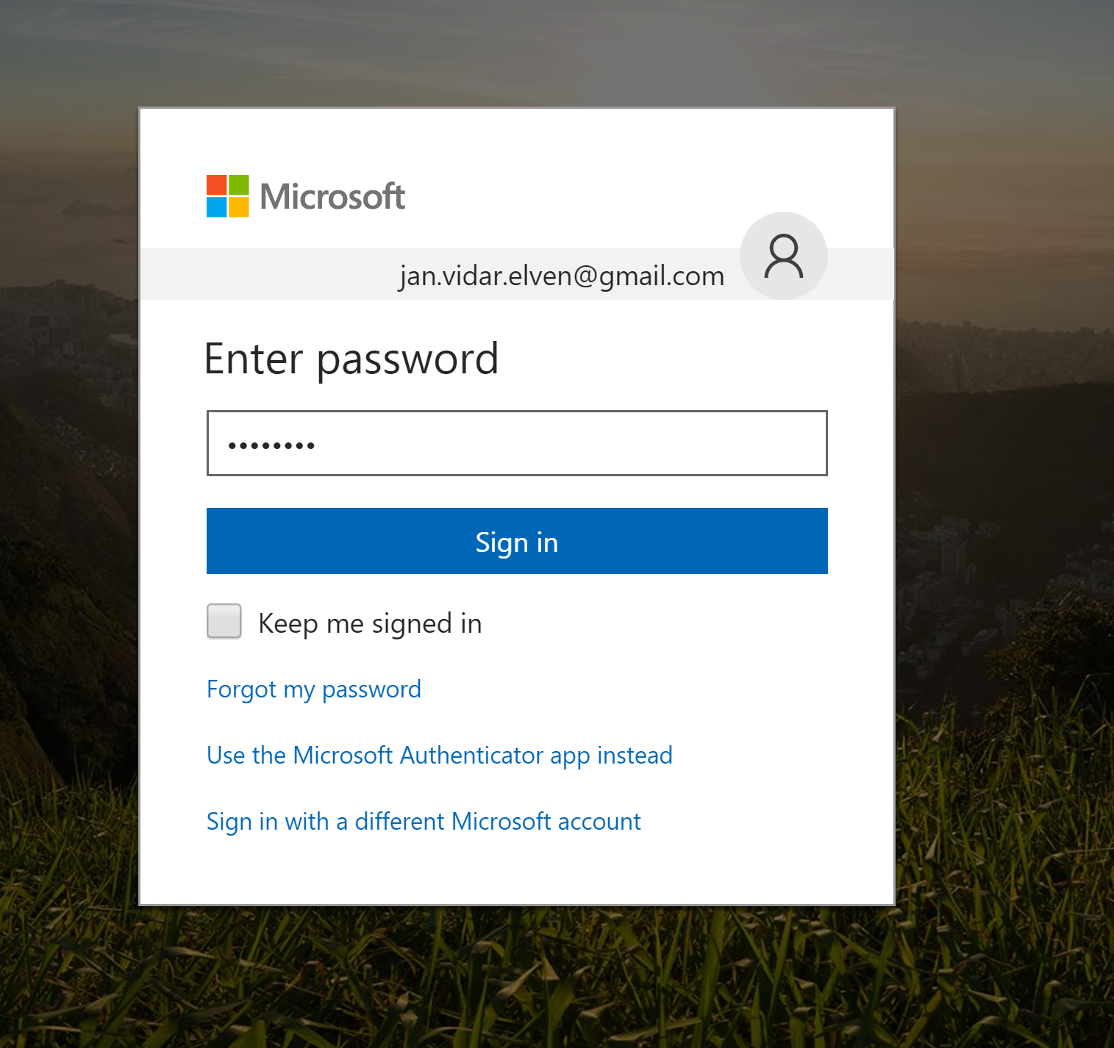
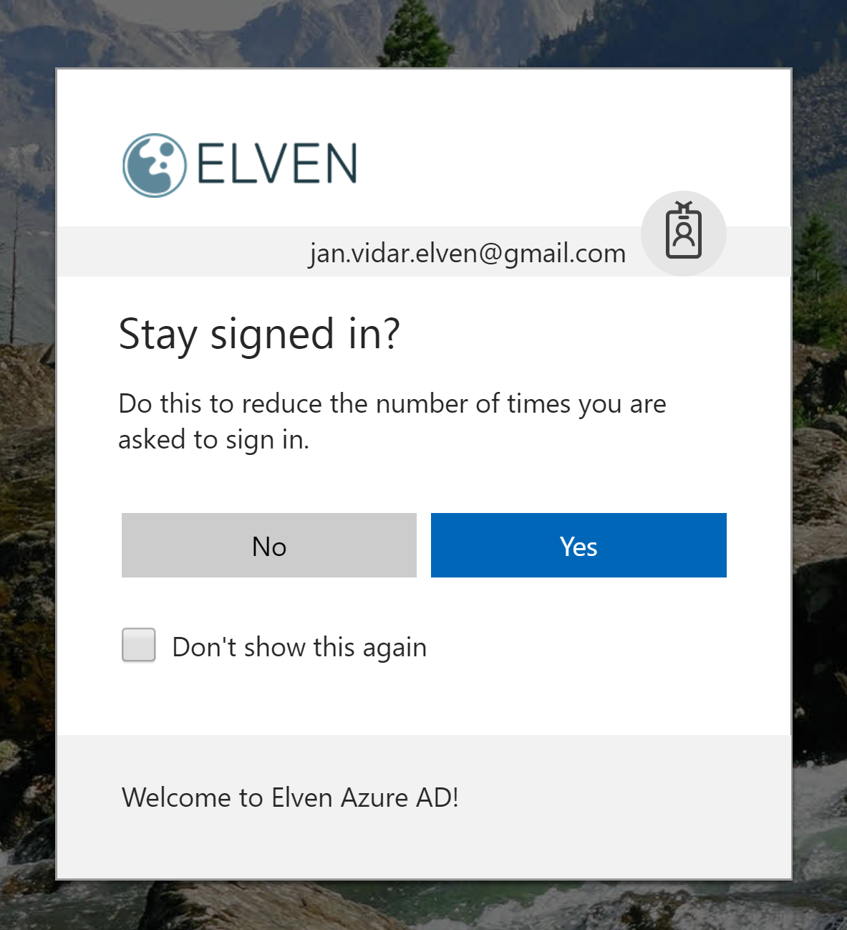
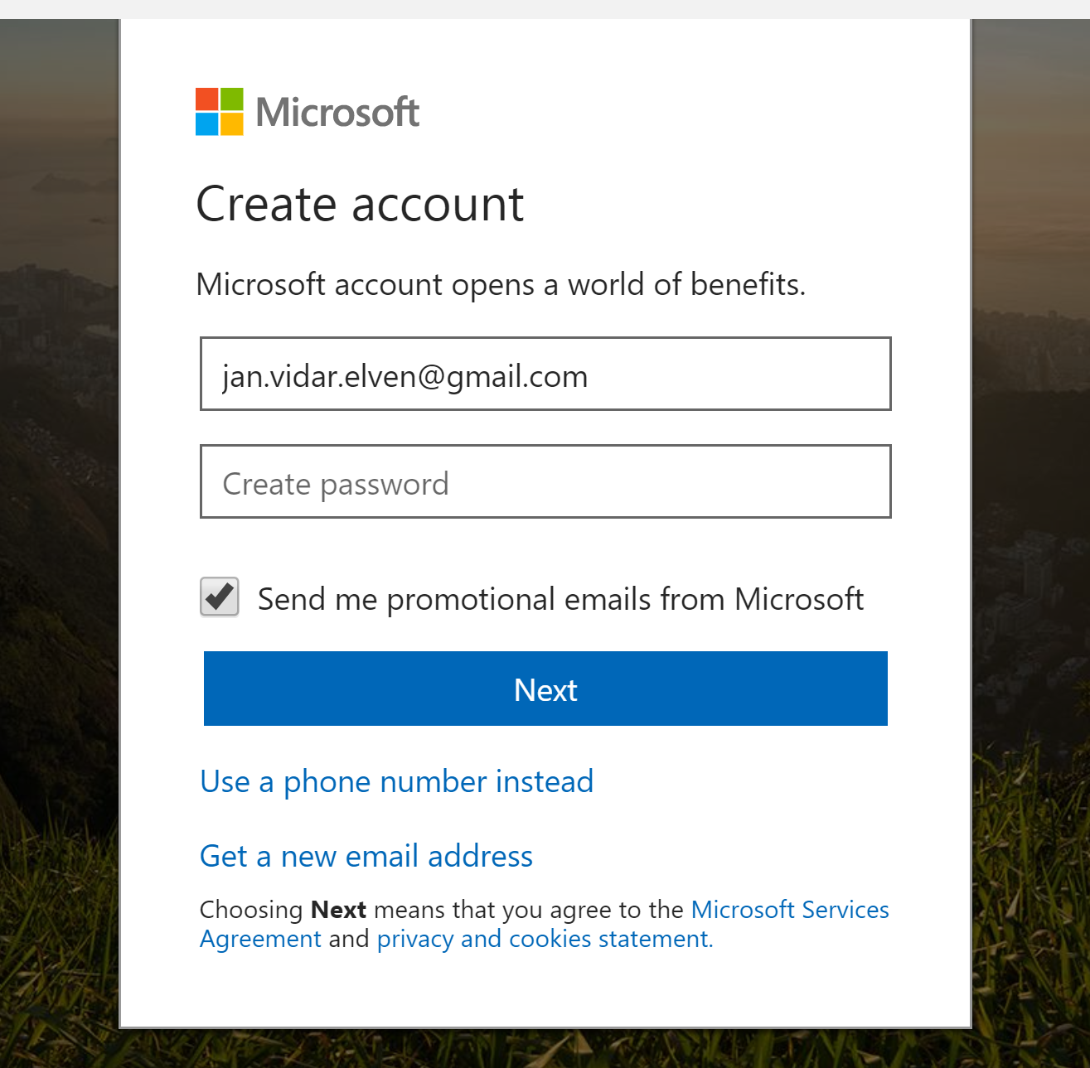
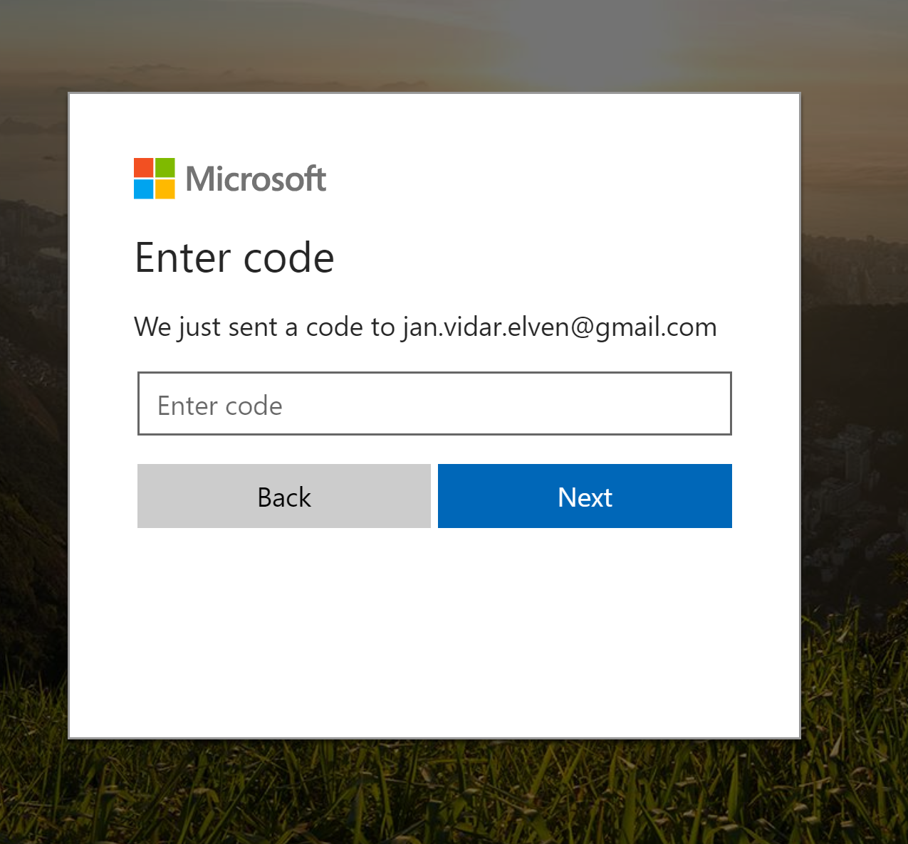
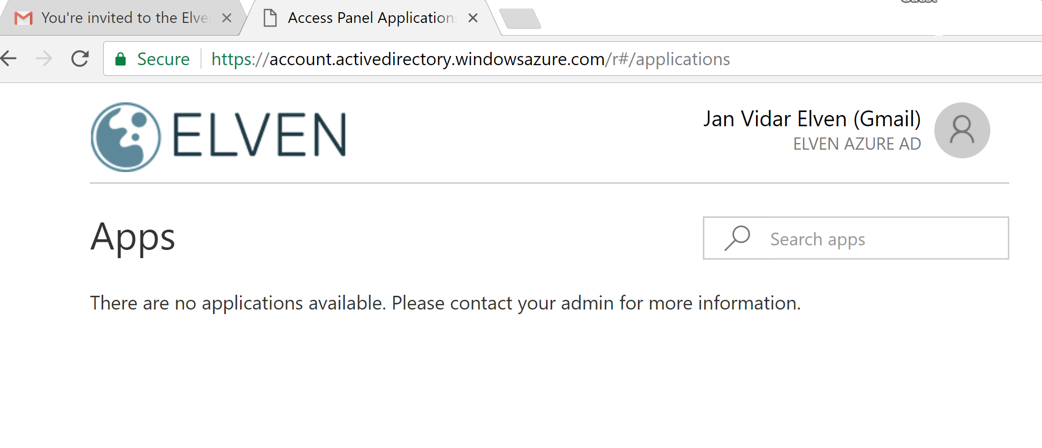
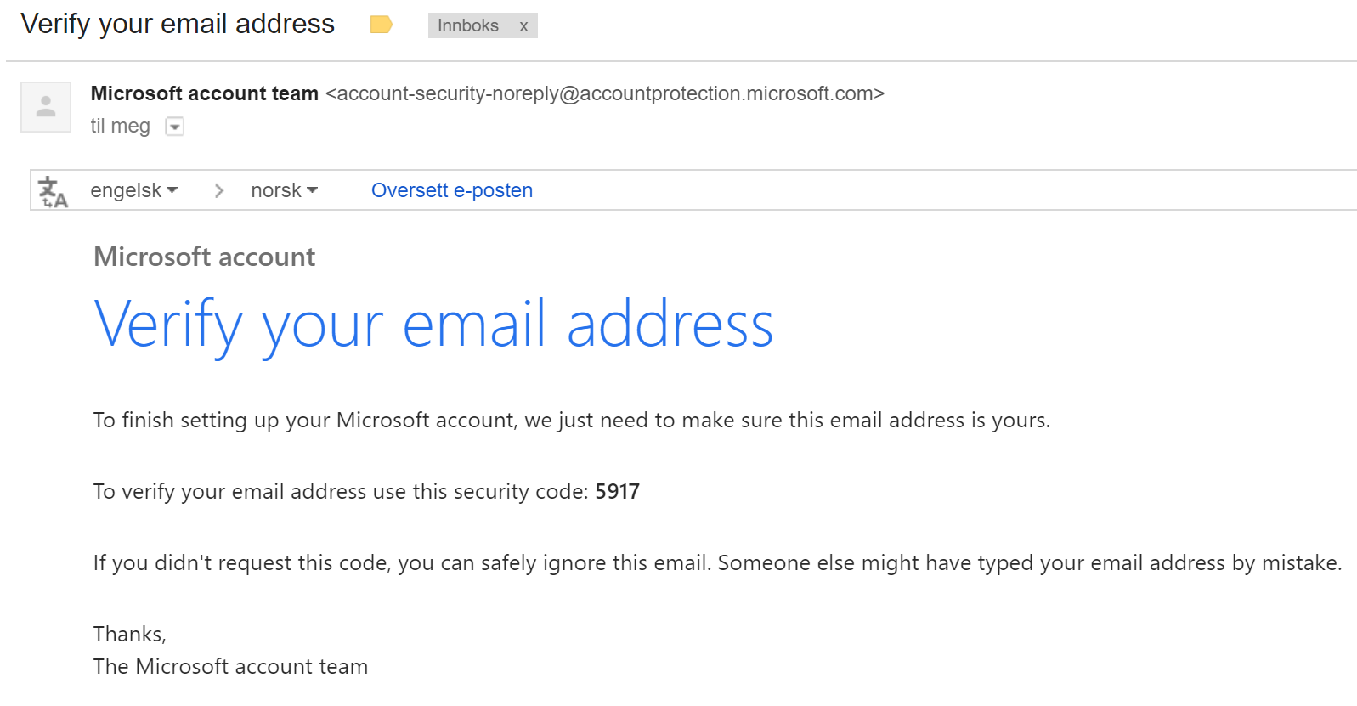
Invitation Redemption Social ID

Slide 8
Special Cases
Invited user does not have e-mail?
Add guest users without invitation?
Hybrid Guests
Notes:
https://docs.microsoft.com/en-us/azure/active-directory/active-directory-b2b-add-user-without-invite
https://docs.microsoft.com/en-us/azure/active-directory/active-directory-b2b-hybrid-organizations

Slide 9
DEMO

Slide 10
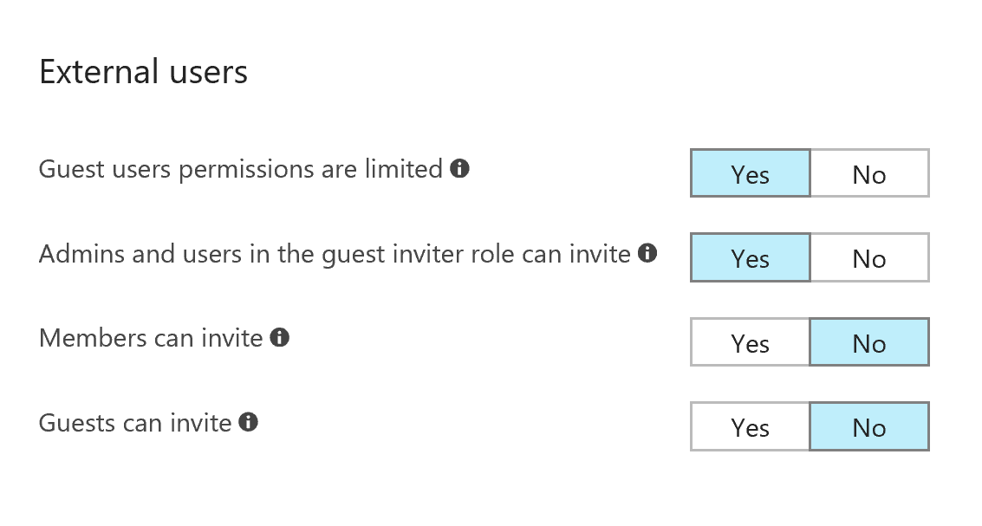
Settings and Control

Slide 11
Office 365 External Sharing & B2B
All Office 365 services already use Azure AD B2B collaboration invitation APIs for sharing
EXCEPT:
SharePoint Online
OneDrive for Business
Settings for Sharing in Office 365 Admin Center / SharePoint Admin Center
Notes:
OneDrive/SharePoint Online adds users to the directory after users have redeemed their invitations. So, before redemption, you don't see the user in Azure AD portal. If another site invites a user in the meantime, a new invitation is generated. However, when you use Azure AD B2B collaboration, users are added immediately on invitation so that they show up everywhere.
The redemption experience in OneDrive/SharePoint Online looks different from the experience in Azure AD B2B collaboration. After a user redeems an invitation, the experiences look alike.
Azure AD B2B collaboration invited users can be picked from OneDrive/SharePoint Online sharing dialog boxes. OneDrive/SharePoint Online invited users also show up in Azure AD after they redeem their invitations.
https://docs.microsoft.com/en-us/azure/active-directory/active-directory-b2b-o365-external-user

Slide 12
DEMO

Slide 13
Conditional Access for B2B Users
Multi-Factor Authentication (MFA)
Device-based, location-based, risk-based conditional access?
Enforced at Resource Organization
Requires Azure AD Premium at Resource Organization
1:5 ratio
Terms of Use CA (Preview)
See Jan-Ketil Skanke and Ronni Pedersen’s session for more:
“Azure AD B2B Conditional Access Advanced Scenarios”, tomorrow 02.02 11:10

Slide 14
Resources
Slides and demos from the conference will be available at github.com/nordicinfrastructureconference/2018 (bit.ly/2y7JhA3)
https://docs.microsoft.com/en-us/azure/active-directory/active-directory-b2b-what-is-azure-ad-b2b
Github.com/skillriver
@skillriver | gotoguy.blog

